Slide 1

Adidas sales analysis
Roshan Joseph
0852827

Slide 2
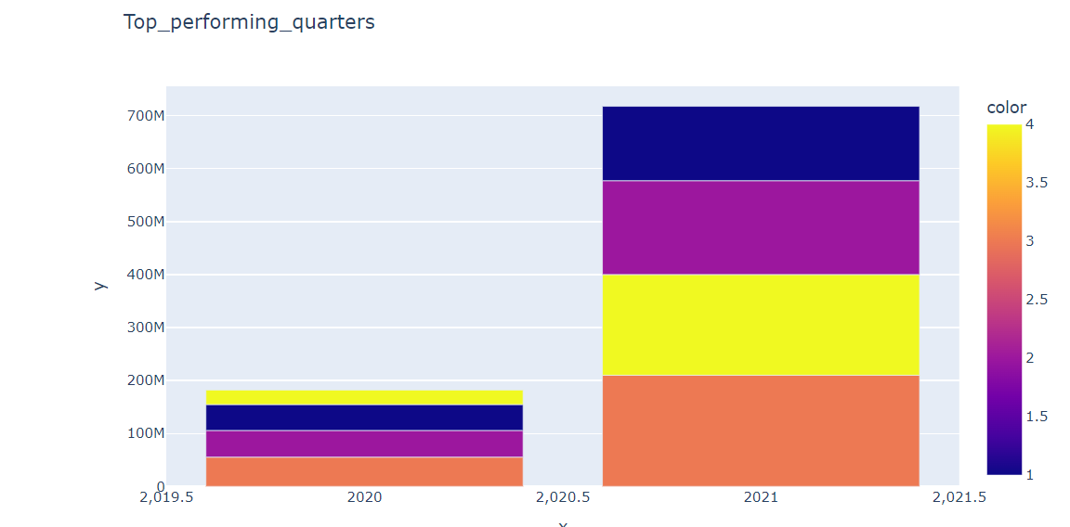
Top Performing Quarters
INSIGHT:
All four quarters in 2020 had relatively low performance
All quarters show a substantial rise in performance in 2021 compared to the previous year.
Q3 is the dominant quarter in both the years
Sales in 2021 has quadrupled compared to 2020
Recommendations:
Allocate more resources during Q3 to maximize sales.
Analyse Q3 performance drivers to replicate the success to other quarters.
Invest in customer retention strategies to ensure sustained engagement with new customers acquired during the growth phase.
Identify factors contributing to lower performance in these quarters and develop targeted strategies (e.g., discount offers, partnerships, or new product releases) to boost sales.

Slide 3
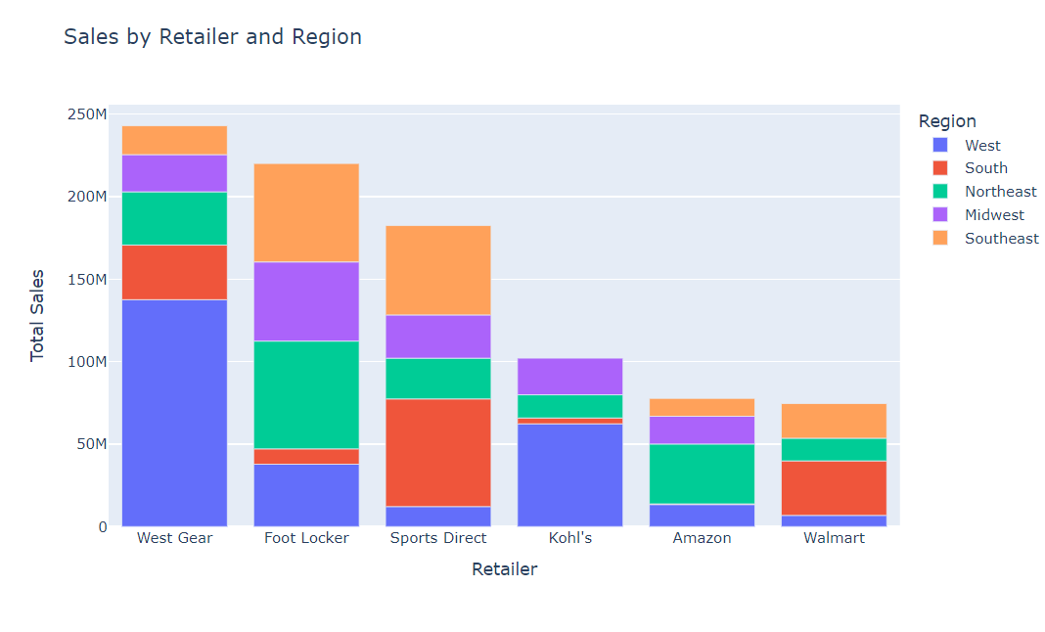
Sales by retailer and region
INSIGHT:
West Gear is the top-performing retailer, heavily dominated by sales in the West region.
Foot Locker and Sports Direct are the next highest-performing retailers. Their sales are more evenly distributed across multiple regions.
Amazon and Walmart have the lowest total sales among the listed retailers
Recommendations:
As West Gear dominates in the West region, Adidas should prioritize product placement and exclusive collaborations here.
Collaborate with West Gear to expand their reach to other high-potential regions.
Focus on boosting Adidas's product visibility on Amazon leveraging Amazon’s technological features.
Work with Walmart to ensure affordable Adidas product lines are available.

Slide 4
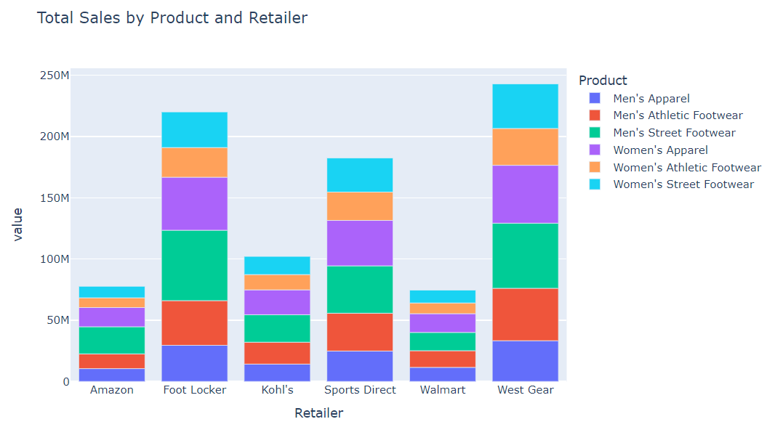
Sales by product and retailer
INSIGHT:
All product categories has sales in each retailer
There is not much difference in the sale of product categories in each retailers
Recommendations:
offer exclusive product lines tailored to their audience
like limited edition sneakers or apparels
Premium products can be introduced to create excitement and attract loyal customers

Slide 5
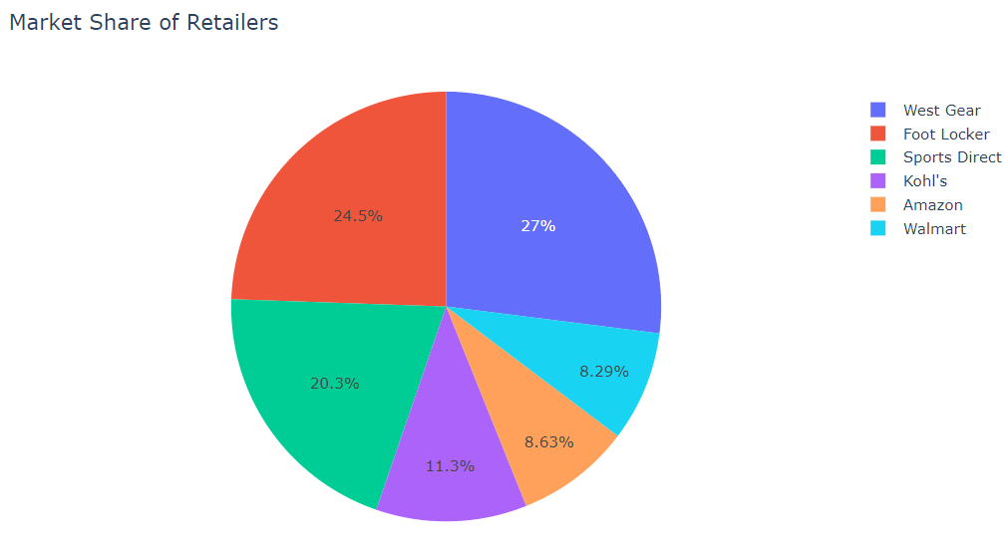
Market share of retailers
INSIGHT:
With 27% market share, West Gear is the leader in this sector.
Foot Locker holds 24.5% and is the second leading retailer.
Sports Direct accounts for 20.3%, placing it third in the retailer hierarchy.
Kohl's (11.3%), Amazon (8.63%), and Walmart (8.29%) collectively represent a smaller portion of the market.
Recommendations:
maintain leadership for west gear by investing in customer retention strategies and expanding its product portfolio.
Focus on aggressive marketing and promotional campaigns for foot locker

Slide 6
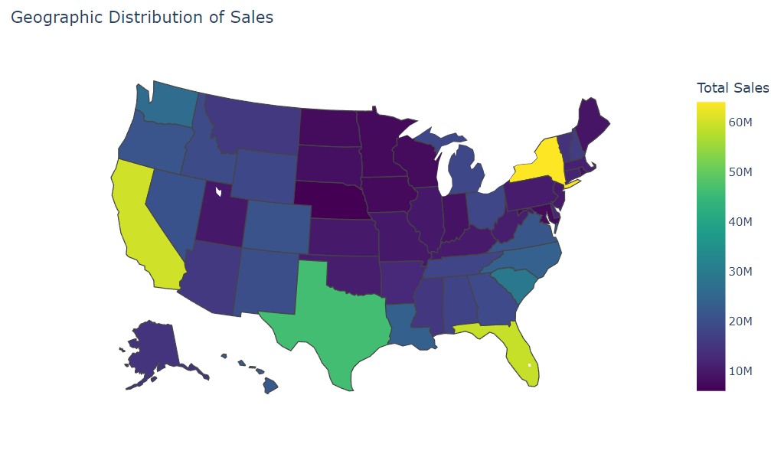
Geographic distribution of sales
INSIGHT:
States like New York, California and Florida appear to have the highest sales (60M)
States like Texas has medium sales (46M).
States like Nebraska have the lowest sales (6M)
Recommendations:
Focus on high-performing states with targeted advertising campaigns, especially in urban areas.
Focus marketing campaigns and offer discounts to increase market share in regions with moderate sales.
Run awareness campaigns to build brand and product familiarity in regions with low sales.

Slide 7
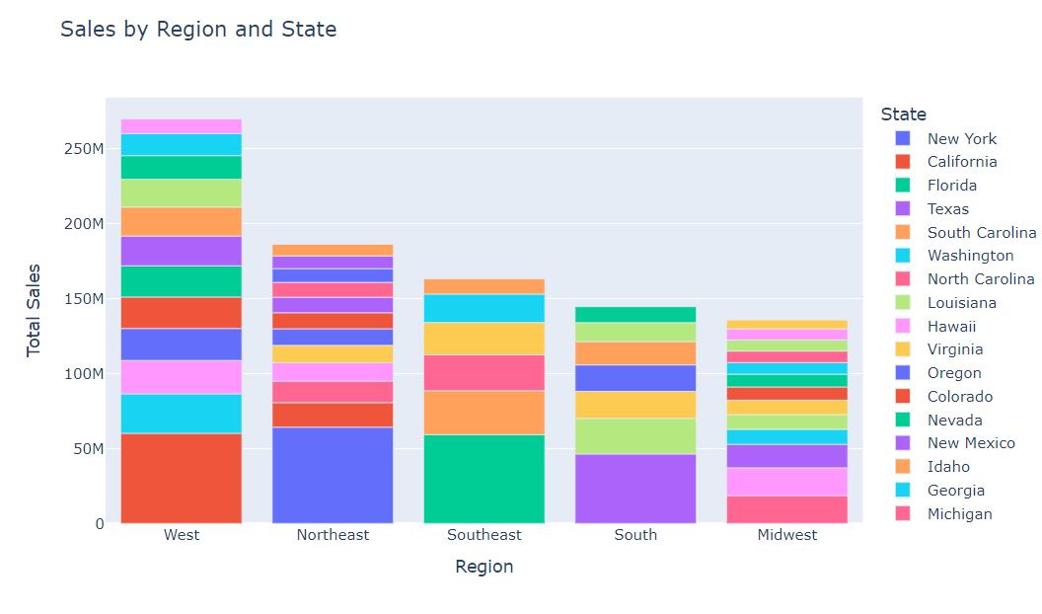
Sales by region and state
INSIGHT:
The West region leads with 250M+ total sales, driven primarily by California and other high-performing states.
The Northeast region is the second-largest contributor, with New York dominating.
The Midwest lags behind, contributing the least among regions
Recommendations:
Continue capitalizing on the strength of California and neighboring states.
In northeast regions focus on New York-centric marketing campaigns to enhance overall regional sales.
In Midwest regions research consumer preferences to better align offerings with demand in the Midwest.

Slide 8
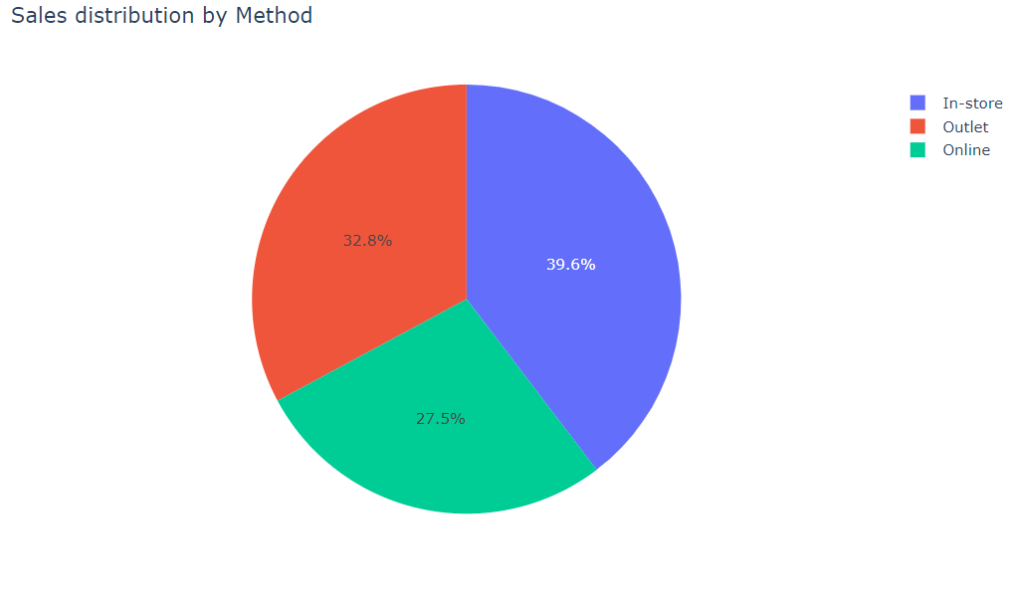
Sales distribution by method
INSIGHT:
The in-store method has the highest sales distribution
Followed by in-store, outlet method has the second highest sales
Online method has the lowest sales distribution
Recommendations:
Focus on in-store method to maximize sales.
Introduce loyalty programs or exclusive in-store discounts to strengthen customer retention
Offer special promotions and bundles at outlets to increase purchase volumes.
Use targeted digital marketing campaigns, including social media ads, email promotions, and search engine optimization, to drive more traffic to online stores

Slide 9
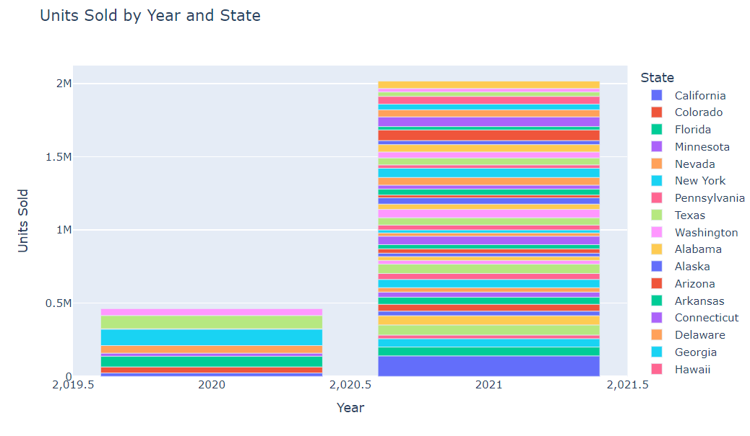
Units sold by year and state
INSIGHT:
There is a sharp increase in the total units sold in 2021 compared to 2020
The contribution of multiple states in 2021 highlights a broad-based growth, suggesting uniform expansion efforts or market recovery
Recommendations:
Implement retention strategies to the new states
Drive growth in underperforming new states by implementing marketing stratergies

Slide 10
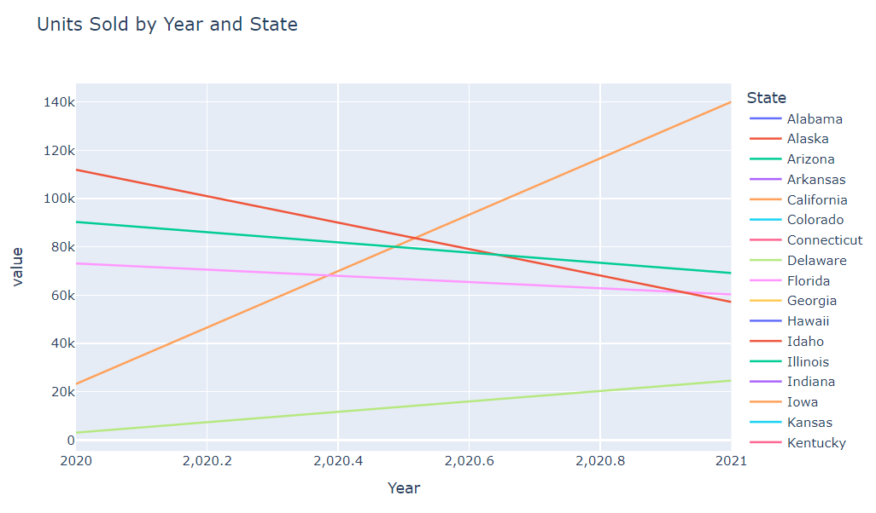
Units sold by Year and state
INSIGHT:
California shows a dramatic increase in units sold from 2020 to 2021, indicating strong growth
New York shows a significant decline in units sold, indicating potential challenges in that market.
Recommendations:
For High-Growth States identify and replicate the strategies that contributed to the growth
Ensure continued investment in the high growth states to maintain momentum and further capture market share.
For Declining States conduct detailed root cause analysis to identify reasons for the decline

Slide 11
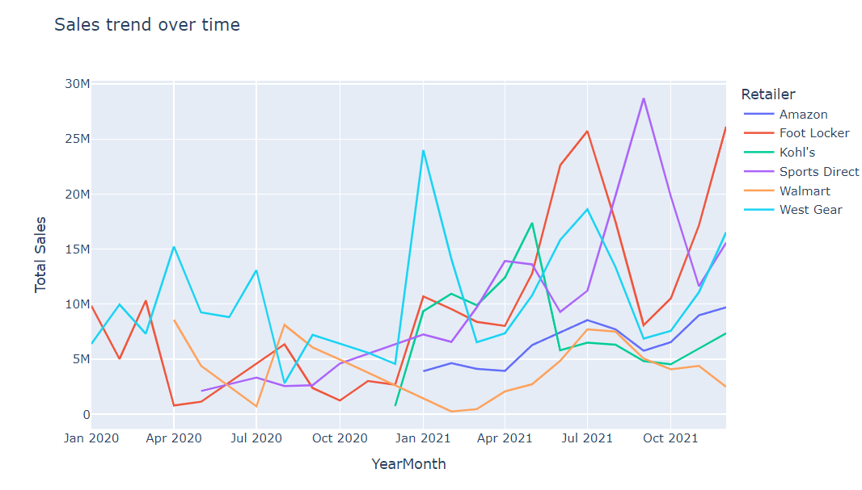
Sales trend by retailer
INSIGHT:
West Gear and Foot Locker show significant spikes in sales at multiple points in time which suggests seasonality or the impact of certain campaigns.
Sports Direct has steady growth with occasional peaks which indicates consistent performance with periodic boosts to sales.
Amazon and Kohl's exhibit slower, steadier growth, while Walmart demonstrates a decline post-mid-2020
Recommendations:
Build on the success of West Gear and Foot Locker's spikes during high-sales periods by planning campaigns around these periods
Investigate why sales are declining and provide stronger merchandising and collaborative marketing support

Slide 12
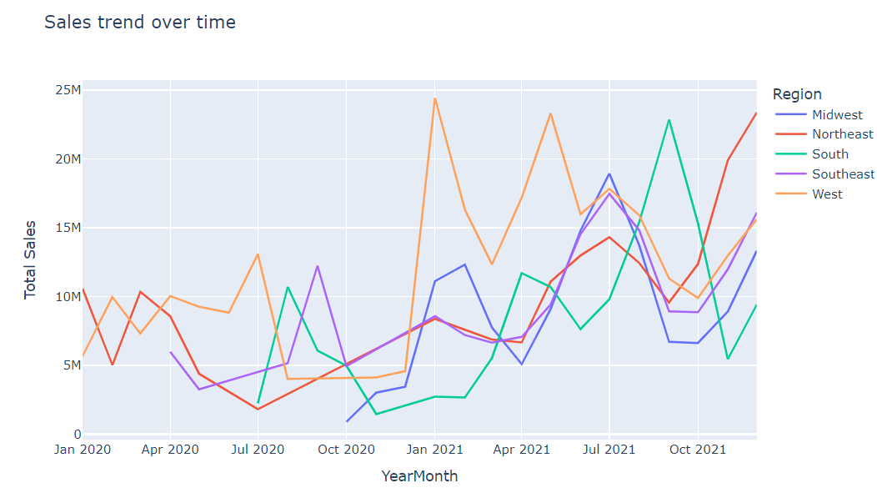
Sales trend by region
INSIGHT:
Sales trends for all regions are highly fluctuating over time which suggests seasonal variations or the impact of other factors like promotions, holidays, or economic conditions.
The Northeast, South, and Southeast regions show more moderate fluctuations, while the West region exhibits more dramatic spikes and drops
Recommendations:
Analyse the factors driving the sharp peaks and implement these strategies during other periods
Use historical data trends to predict seasonal highs and lows and plan campaigns or inventory accordingly

Slide 13
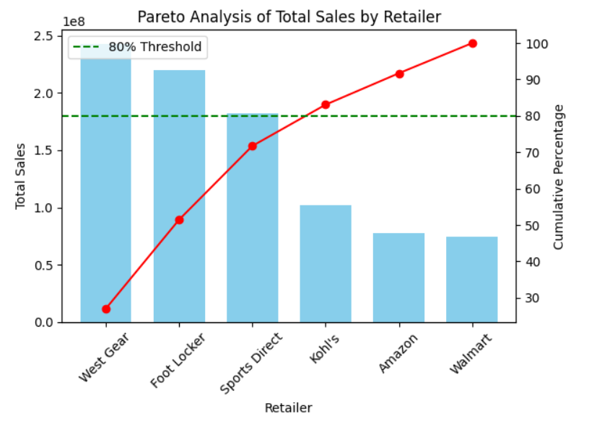
Pareto analysis by retailer
INSIGHT:
West Gear, Foot Locker, and Sports Direct collectively contribute over 80% of total sales. These are the top-performing retailers generating critical contribution to the revenue.
Kohl's, Amazon, and Walmart contribute comparatively less, with their cumulative contribution falling under the 80% mark.
Recommendations:
Strengthen Partnerships with Top Performers by offering exclusive deals, promotions, or incentives
Collaborate on co-marketing campaigns to further boost sales.
Evaluate the reasons for their lower performance and implement targeted marketing initiatives tailored to their customer bases

Slide 14
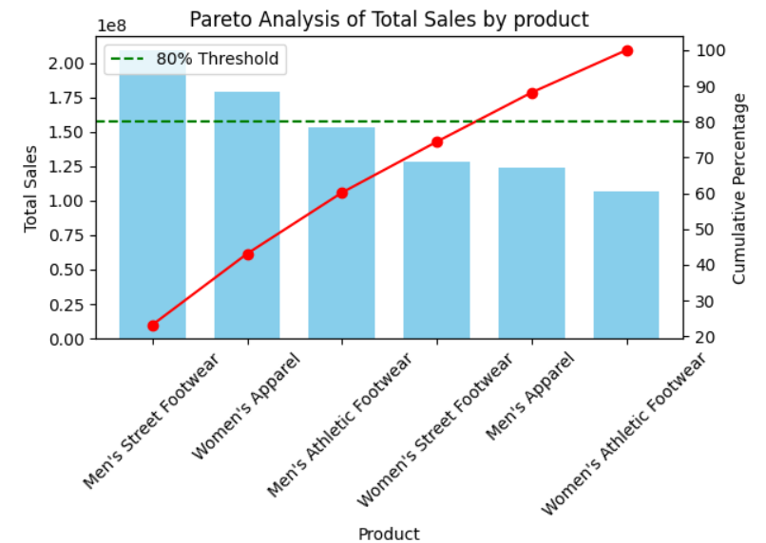
Pareto analysis by product categories
INSIGHT:
Men's Street Footwear and Women's Apparel are the top two contributors to total sales, making up a significant portion of overall revenue.
These products cross the 80% cumulative sales threshold, indicating they are critical to the business's revenue
Recommendations:
Allocate more resources to Men's Street Footwear and Women's Apparel, as they are driving most of the sales.
Consider reducing focus or repositioning Women's Athletic Footwear line.

Slide 15
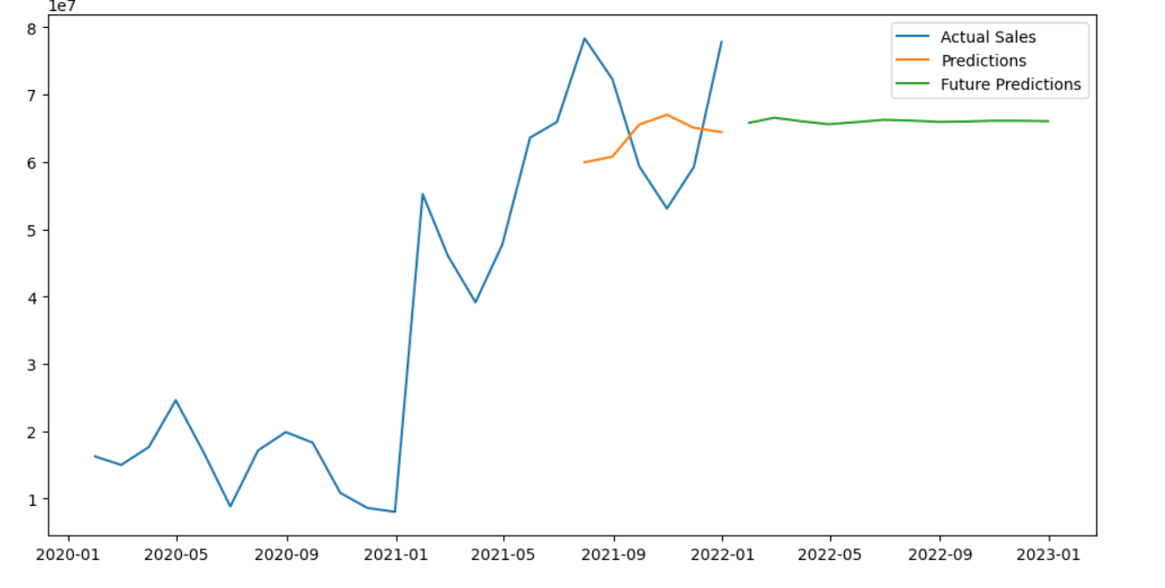
Sales forecasting using arima model

Slide 16
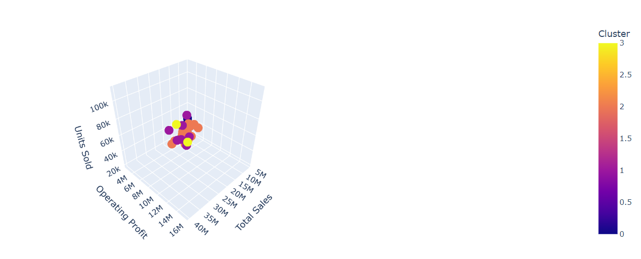
Clustering cities
Clustering cities based on sales, operating profit and units sold

Slide 17
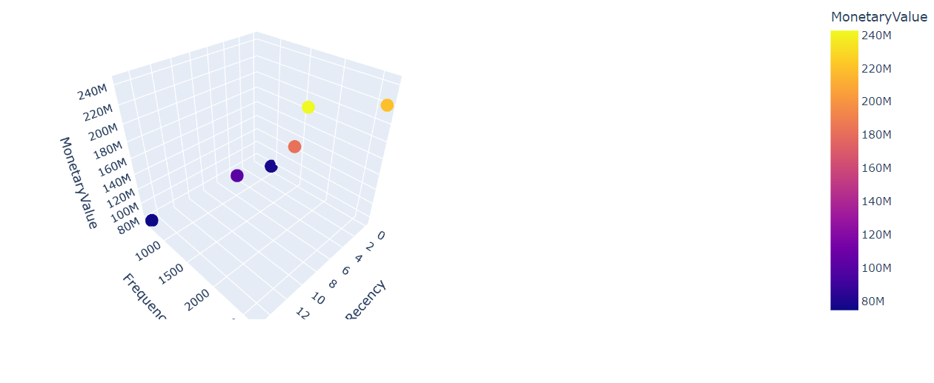
Rfm analysis on retailers

Slide 18
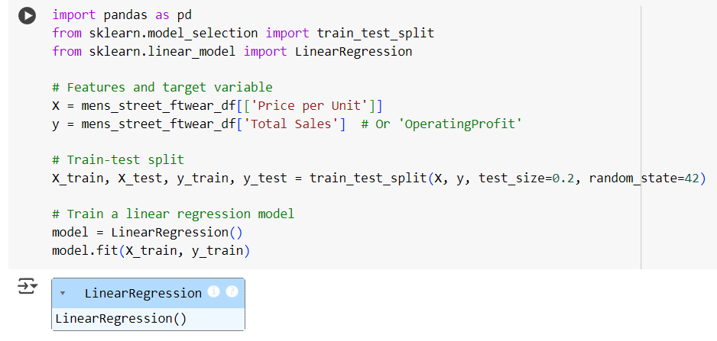
Price optimization using minimize scalar

Slide 19
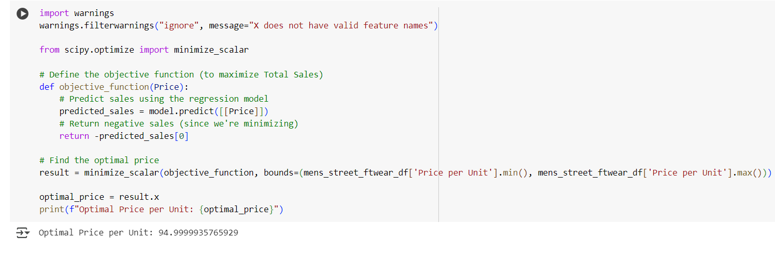
The optimal price for the mens street footwear category is 94.99 dollars

